Slide 1
Lab 8
Socket Programming with UDP
>
TA: Zih-Hong Lin
Prof.: Hsung-Pin Chang
NCHU System & Network Lab

Slide 2
Outline
$
Definition of Socket
Overview of Example
Example Code & APIs
Exercise
2
NCHU System & Network Lab

Slide 3
Definition of Socket (1/3)
$
First developed at the University of California, Berkeley for use on Unix systems -> Berkeley Socket
All modern OS now have some implementation of the Berkeley socket interface -> the standard interface for connecting to the Internet
3
NCHU System & Network Lab

Slide 4
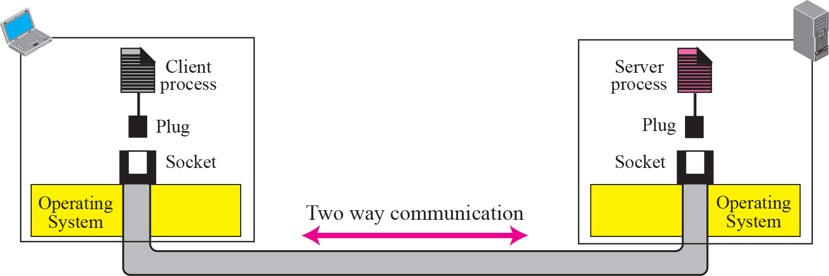
Definition of Socket (2/3)
$
Socket allows communications between hosts or between processes on one computer
4
NCHU System & Network Lab

Slide 5
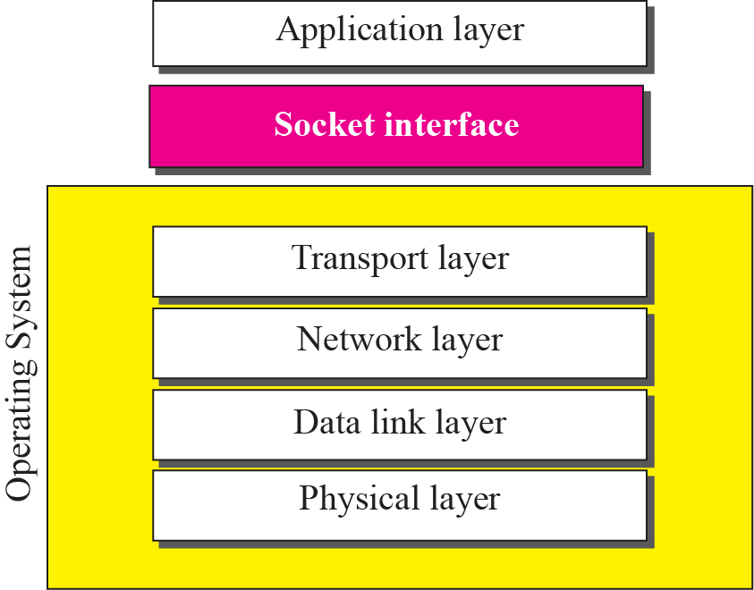
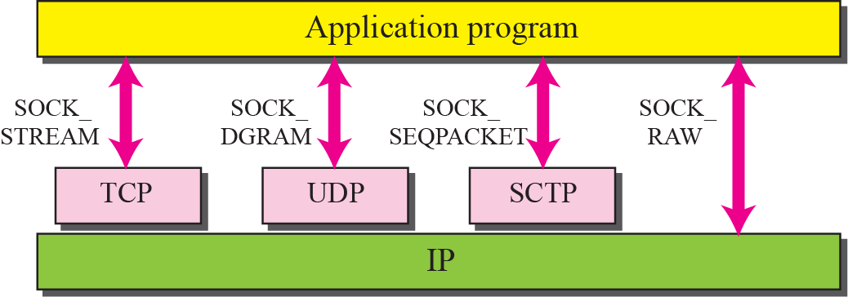
Definition of Socket (3/3)
$
5
NCHU System & Network Lab

Slide 6
Outline
$
Definition of Socket
Overview of Example
Example Code & APIs
Exercise
6
NCHU System & Network Lab

Slide 7
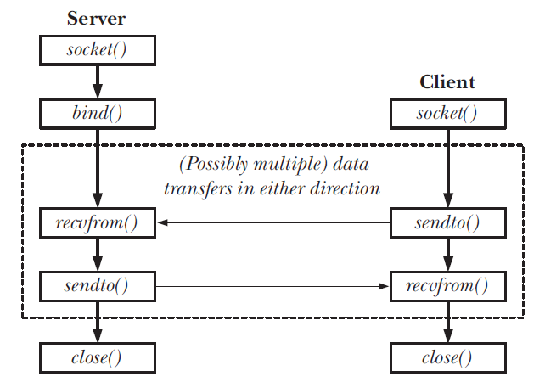
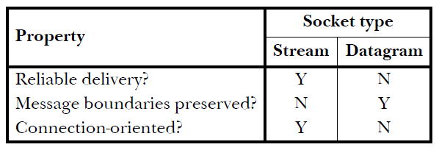
Overview of Example
$
7
NCHU System & Network Lab

Slide 8
Outline
$
Definition of Socket
Overview of Example
Example Code & APIs
server.c
client.c
Result
Exercise
8
NCHU System & Network Lab

Slide 9
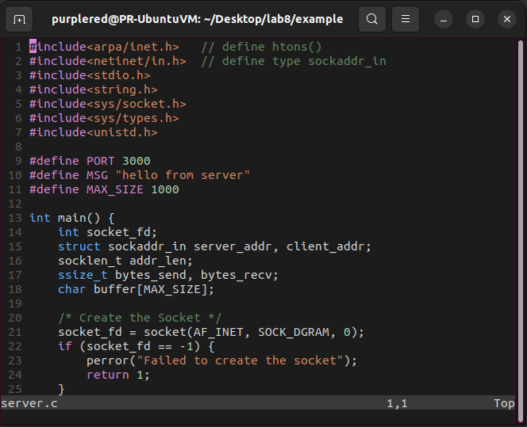
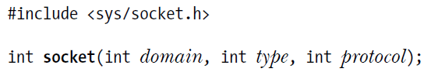

server.c (1/14)
$
socket()
A system call that creates a new socket
Returns file descriptor on success, or –1 on error
domain
AF_INET: IPv4
AF_INET6: IPv6
AF_UNIX: UNIX (for local communication)
AF: Address Family
9
NCHU System & Network Lab

Slide 10
server.c (2/14)
$
socket() (Cont.)
type
SOCK_DGRAM: UDP
SOCK_STREAM: TCP
SOCK_SEQPACKET: SCTP
SOCK_RAW
PPT p.6
protocol
0: default protocol
10
NCHU System & Network Lab

Slide 11
server.c (3/14)
$
sockaddr_in structure
IPv4 Socket Address Structure, commonly called "Internet socket address structure"
Each supported protocol suite defines its own socket address structure
The names of these structures begin with "sockaddr_" and end with a suffix for each protocol suite
11
NCHU System & Network Lab

Slide 12
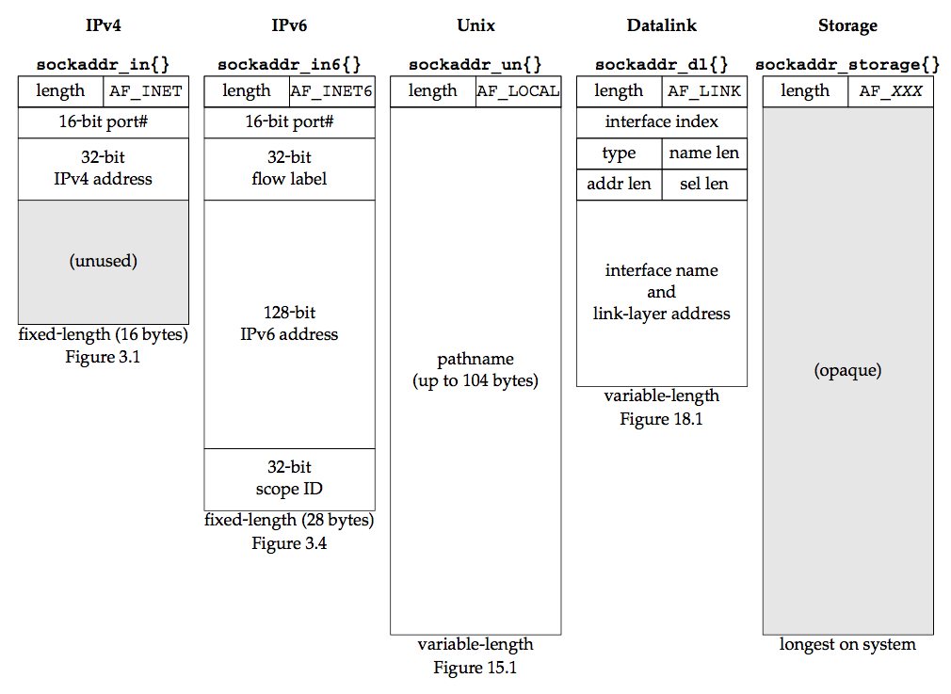
server.c (4/14)
$
Comparison of socket address structures
12
NCHU System & Network Lab

Slide 13
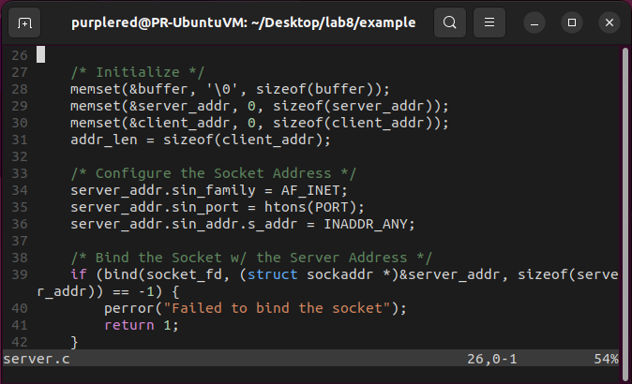
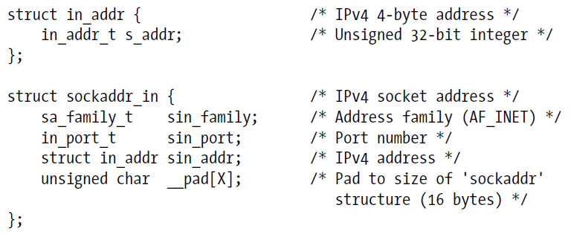
server.c (5/14)
$
sockaddr_in structure (Cont.)
13
NCHU System & Network Lab

Slide 14
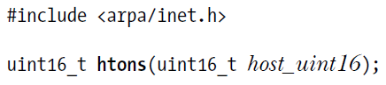
server.c (6/14)
$
htons()
Converts "host byte order" to "network byte order" (big endian)
s means "unsigned short integer"
It also have htonl(), ntohs() and ntol()
host_uint16: port number, we defined on line 9
14
NCHU System & Network Lab

Slide 15
server.c (7/14)
$
INADDR_ANY macro
IPv4 wildcard address
Equals 0.0.0.0
Line 35 means "binding to all available network cards"
15
NCHU System & Network Lab

Slide 16
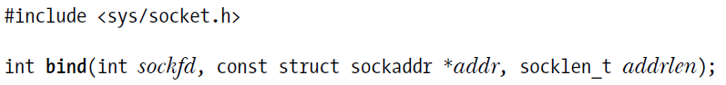
server.c (8/14)
$
bind()
A system call that bind a socket to an address
Returns 0 on success, or –1 on error
sockfd: socket file descriptor
addr: server's socket address structure
addrlen: length of addr
16
NCHU System & Network Lab

Slide 17
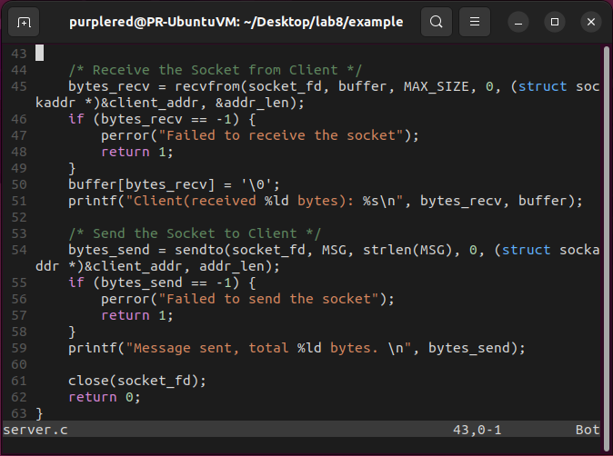
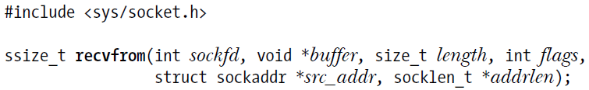
server.c (9/14)
$
recvfrom()
A system call that receive datagrams on a datagram socket
Returns number of bytes received, 0 on EOF, –1 on error
sockfd: socket file descriptor
buffer: where we store the received datagram
length: the maximum length of the datagram we can receive
17
NCHU System & Network Lab

Slide 18
server.c (10/14)
$
recvfrom() (Cont.)
flags
A bit mask controlling socket-specific I/O features
We don't require this feature so specify as 0
src_addr: sender's socket address structure
addrlen: length of src_addr
18
NCHU System & Network Lab

Slide 19
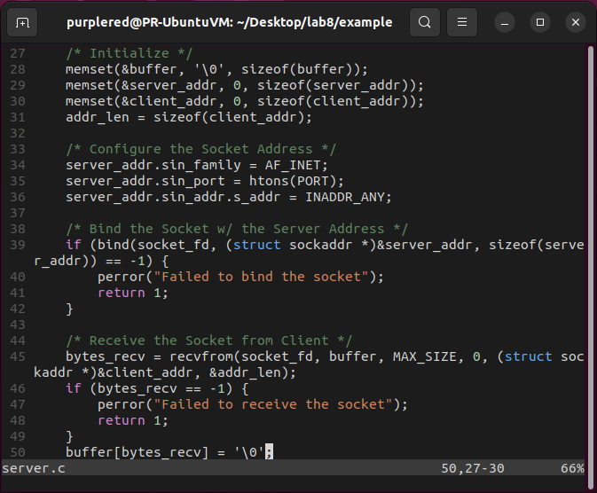

server.c (11/14)
$
Why we need to do line 50, even if we did memset() on line 28?
19
NCHU System & Network Lab

Slide 20
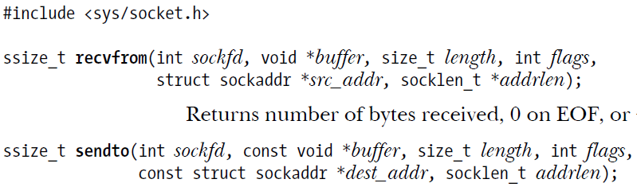
server.c (12/14)
$
sendto()
A system call that send datagrams on a datagram socket
Returns number of bytes sent, or –1 on error
sockfd: socket file descriptor
buffer: where we store the datagram preparing to send
length: length of buffer
20
NCHU System & Network Lab

Slide 21
server.c (13/14)
$
sendto() (Cont.)
flags: like PPT p.17, specify as 0
dest_addr: receiver's socket address structure
addrlen: length of dest_addr
21
NCHU System & Network Lab

Slide 22
server.c (14/14)
$
Last but not least
Close the socket before exit the program
Because you are a good good programmer :)
22
NCHU System & Network Lab

Slide 23
Outline
$
Definition of Socket
Overview of Example
Example Code & APIs
server.c
client.c
Result
Exercise
23
NCHU System & Network Lab

Slide 24
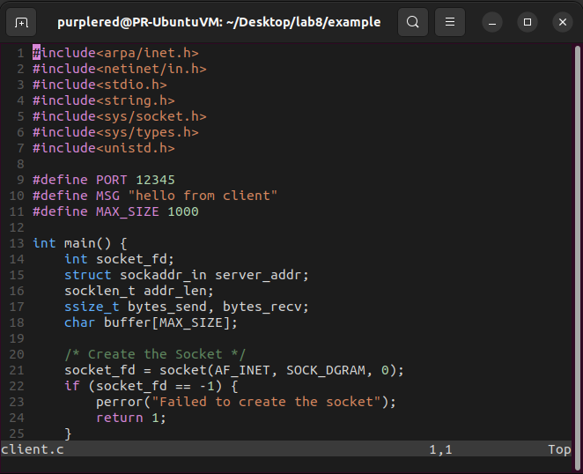
client.c (1/3)
$
Is similar to server.c but…
Client doesn't need to bind()
Client has to know server's IP address
Client send first and waiting for the response, server just the opposite
24
NCHU System & Network Lab

Slide 25
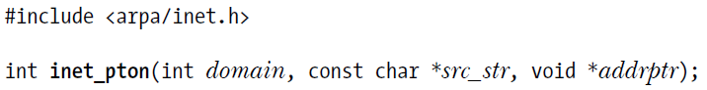
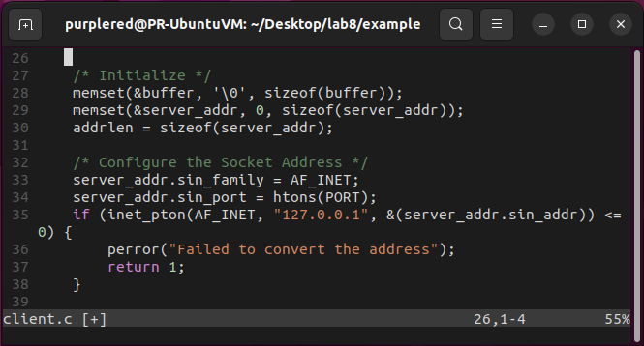
client.c (2/3)
$
inet_pton()
Converts human-readable IP address to binary form
p means "presentation"
n means "network"
domain: like PPT p.8, specify as AF_INET
src_str: server's IPv4 address
addrptr: point to in_addr structure (PPT p.12)
25
NCHU System & Network Lab

Slide 26
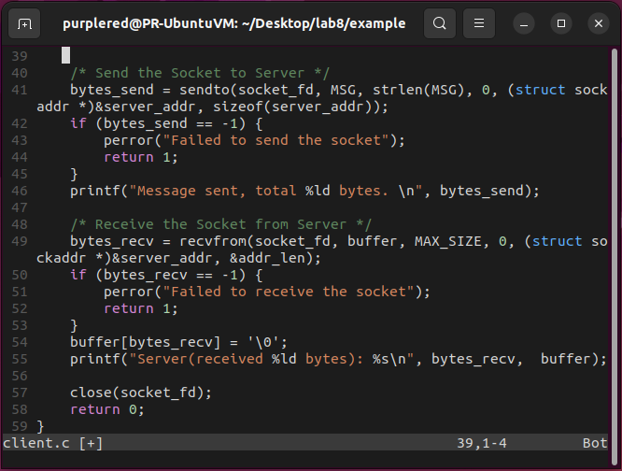
client.c (3/3)
$
Is similar to server.c but…
Client doesn't need to bind()
Client has to know server's IP address
Client send first and waiting for the response, server just the opposite
26
NCHU System & Network Lab

Slide 27
Outline
$
Definition of Socket
Overview of Example
Example Code & APIs
server.c
client.c
Result
Exercise
27
NCHU System & Network Lab

Slide 28
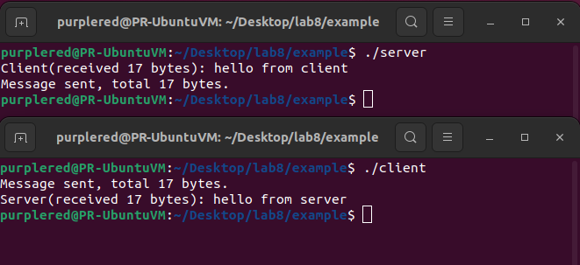
Result
$
Don't forgot to run server first
28
NCHU System & Network Lab

Slide 29
Outline
$
Definition of Socket
Overview of Example
Example Code & APIs
server.c
client.c
Result
Exercise
29
NCHU System & Network Lab

Slide 30
Exercise (1/2)
$
請改良 client.c 和 server.c
client 可以一直發送訊息，直到輸入 "exit"
輸入 "exit" 後，兩支程式需自動關閉
需印出傳送的 byte 數量
不用交程式碼，2023/11/01 23:55 前找任一助教 demo
30
NCHU System & Network Lab

Slide 31
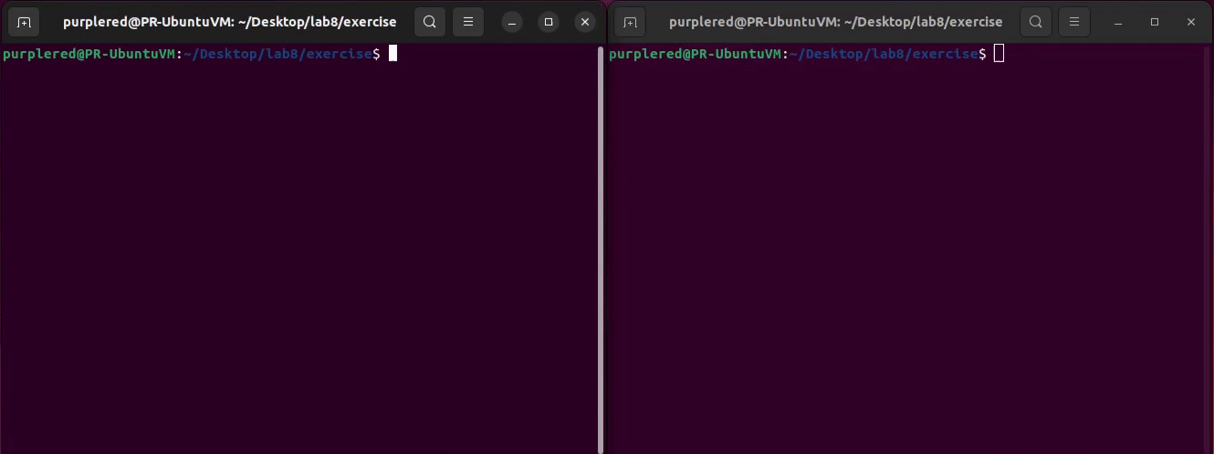
Exercise (2/2)
$
Please follow the result below
31
NCHU System & Network Lab

Slide 32
Made by PurpleRed in 2023/07
>
Thanks for
your listening

